Slide 1

Part 2: Recommender systems in production
David Diebold
Martin Bompaire
Victor Paltz
Notes:
Purpose of this presentation is not to give you an exhaustive presentation of knn algorithms.
We will try to focus on HnswLib.

Slide 2
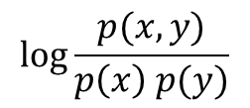
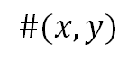
Where did we stop ?
User timelines
PMI
Product pair counts
p₁
p₂
p₅
…
$$\#(x,y)$$
p₁
p₉
p₆
…
$$\log{\frac{p(x, y)}{p\left(x\right) p(y)}}$$
p₇
p₁
p₂
…
From an explicit or implicit user signal coming from user timelines, we can create product embeddings that encode product affinity through cosine similarity in a dense vectorial space
product embeddings
Randomized SVD

Slide 3
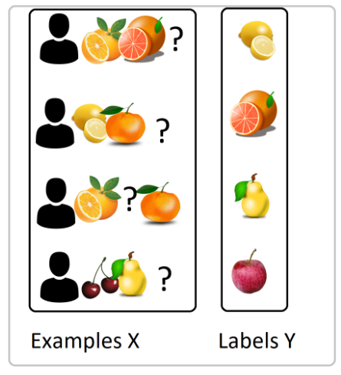
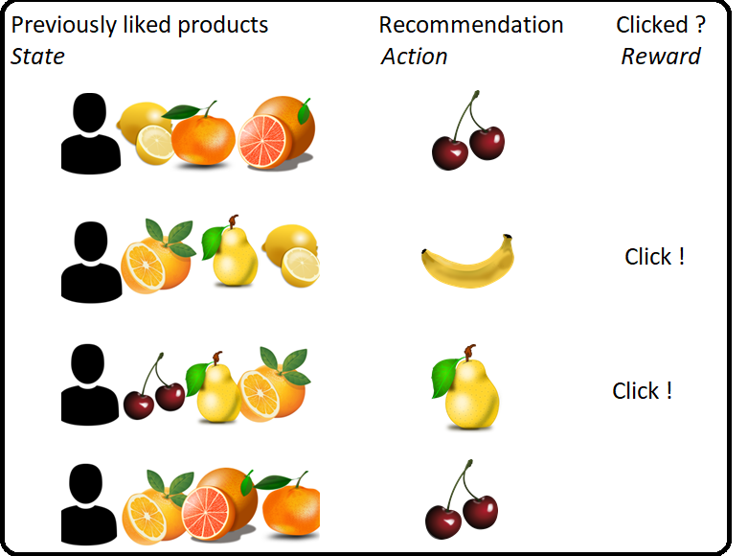
Bandit VS Organic
Organic
Bandit

Slide 4
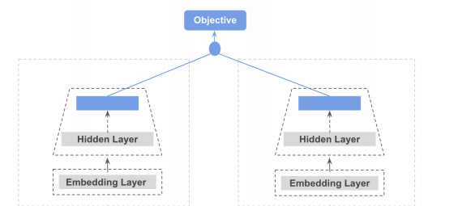
Deep learning model to learn the Bandit signal
(Click or no click)
Input: list of product embeddings seen by user.
Model inferred online
Precompute offline the finetuned product embeddings and store it in a KNN

Slide 5
Where did we stop ?
User timelines
PMI
Product pair counts
p₁
p₂
p₅
…
$$\#(x,y)$$
p₁
p₉
p₆
…
$$\log{\frac{p(x, y)}{p\left(x\right) p(y)}}$$
p₇
p₁
p₂
…
Recommended products
Neural network
optimized on clicks
product embeddings
p₁
p₂
p₅
…
Embedding space
product embedding
user embedding
User history
Randomized SVD

Slide 6
Congrat! You can now build a powerful recommendation system! But…
Will it be fast enough?
Will it be cheap enough?
Will it be good enough?
Will it be fast to rebuild enough?

Slide 7
Solution: Choose wisely the KNN algorithm and the DL model

Slide 8
KNN show time!

Slide 9
Overview
Brute-force
Tree based (KD-tree and ANNOY)
Hash based (LSH and Random projections)
Graph based (NSW and HNSW)
Inverted Index (IVF)
Quantized algorithms (IVFPQ)
KNN Fusion
KNN in practice! (Faiss and Autofaiss)
Bonus? (ScaNN, QUIPs)

Slide 10

1 – Brute Force
Notes:
Dragons Blood Tree, Socotra

Slide 11
1. Brute force KNN
Time complexity for k=1
Sometimes, brute force algorithms are just the best choice:
Cheap to compute
Fixed search time
Exact search
We can use any distance function (especially the ones that don’t have the Triangle inequality properties such as the inner product)
Algorithm | Average | Worst
Space | O(n) | O(n)
Search | O(n) | O(n)
Insert | O(1) | O(1)
Delete | O(1) | O(1)

Slide 12
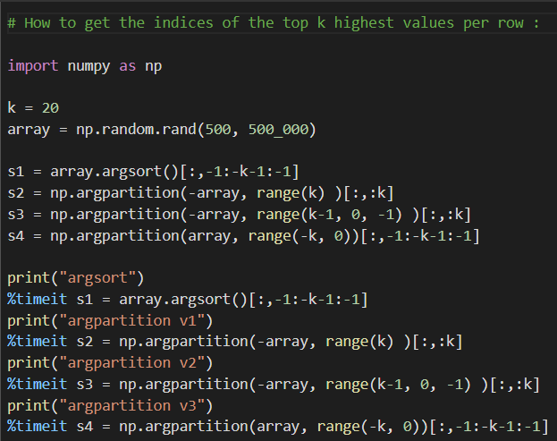
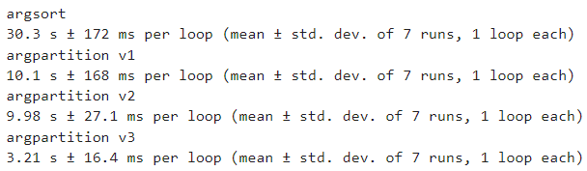
Brute force KNN with numpy
Using heapq.nlargest can be x10 slower, built-in vectorial numpy operations are the best

Slide 13
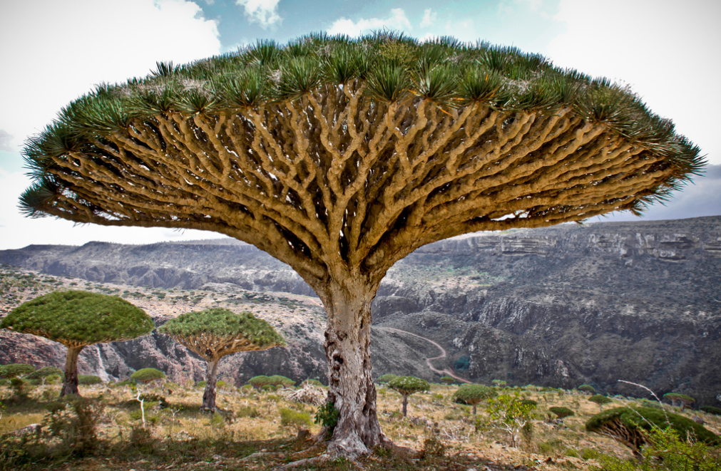
2- Hierarchical Trees
Notes:
Dragons Blood Tree, Socotra

Slide 14
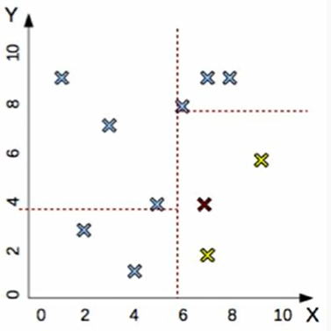
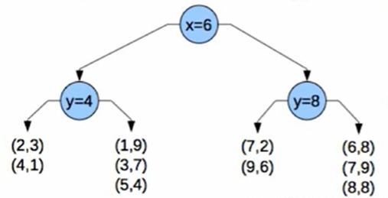
2. KD Tree
Construction
While cell contains ‘too many’ items:
Pick random axis
Find median
Split cell
Time complexity for k=1
Algorithm | Average | Worst
Space | O(n) | O(n)
Search | O(log(n)) | O(log(n))
Insert | O(log(n)) | O(log(n))
Delete | O(log(n)) | O(log(n))
Search
Naïve way: Walk the tree, then look for the nearest neighbor inside the leaf.

Slide 15
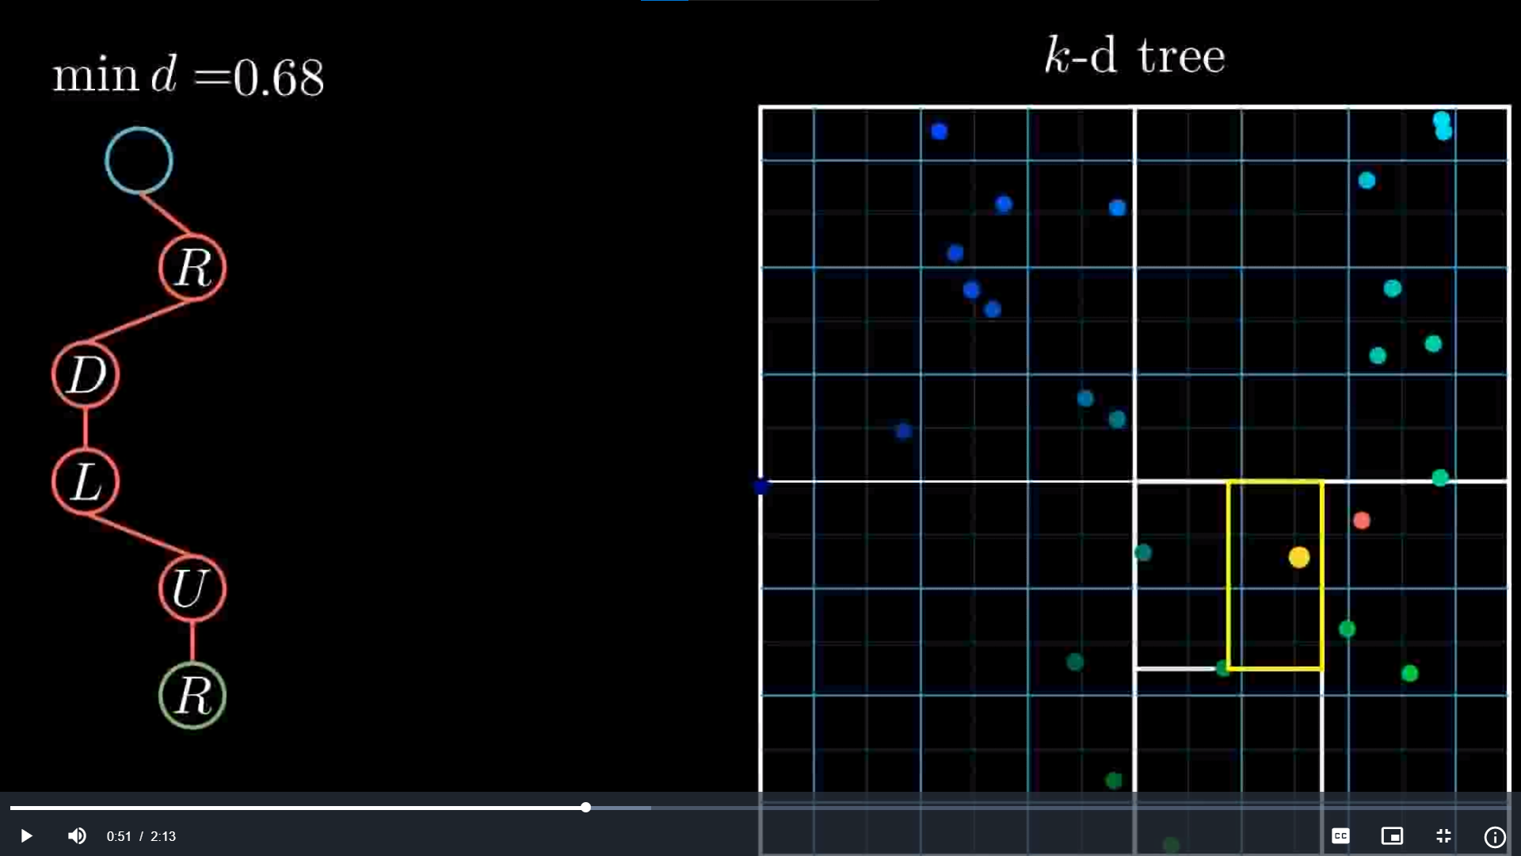
KD Tree: cool animation for exact seach
https://upload.wikimedia.org/wikipedia/commons/4/48/Kdtreeogg.ogv

Slide 16
KD Tree – Exact search
Cell A
Cell E
Cell F
Ideas
It is fast to compute min distance between cell and queried point.
Don’t explore a cell when we know it’s min distance is larger than nearest point found so far.
We use branch-and-bound to find nearest neighbors.
Start with nearest cells first to increase chances to minimize nearest point distance early.
Can be made approximate with some guarantees. Multiply d(query,cell) by (1+Epsilon)
query
Cell B
Cell C
Cell D
Still, not efficient with high dimension vector

Slide 17
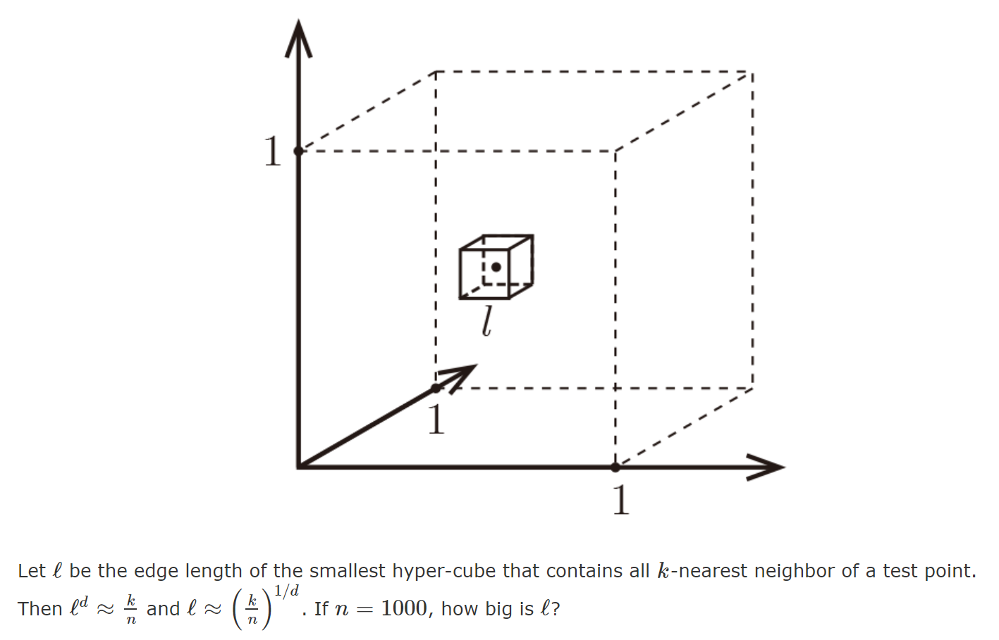
Curse of dimensionality
N points placed uniformly inside the space.

Slide 18
KD Tree - Curse of dimensionality
This effect complicates the nearest neighbor search in high dimensional space.
Indeed, it is not possible to quickly reject candidates by using the difference in one coordinate as a lower bound for a distance based on all the dimensions.
We need other algorithms compatible curse-of-dimension-friendly!

Slide 19
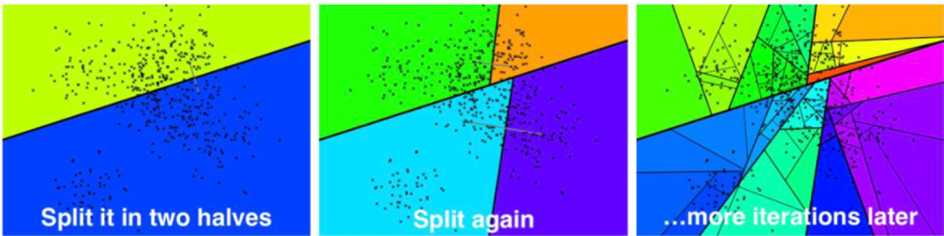
ANNOY
ANNOY (Approximate Nearest Neighbors Oh Yeah) is an algorithm based on random projections and trees. It was developed by Erik Bernhardsson in 2015 working at that time at Spotify. ANNOY is designed to search in date sets up to 100 to 1000 dense dimensions.

Slide 20
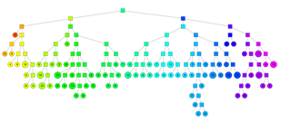
Annoy (Approximate Nearest neighbors Oh Yeah)
Construction
While cell contains ‘too many’ items:
Pick two random points in cell
Split along plane equidistant to the points
Create a Forest !
Search
Branch and bound with additional tricks.
Search on all trees at the same time using same priority queue.
Approximate: don’t explore the other side if it’s too far. Threshold can be changed during the search.
Great performances !

Slide 21

3- Hash based

Slide 22
Locality-sensitive hashing
Here we want to find hash functions for which the hash is correlated to the distance of two vectors
1. Pr(h(a) == h(b)) is high if a and b are near
2. Pr(h(a) == h(b)) is low if a and b are far
3. Time complexity to identify close objects is sub-linear.

Slide 23
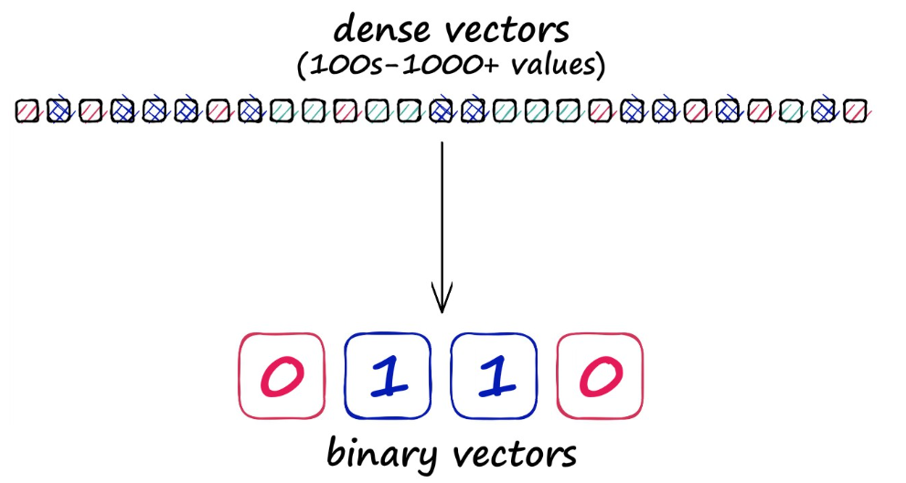
Locality-sensitive hashing
Performing search with LSH consists of three steps:
Index all of our vectors into their hashed vectors.
Introduce our query vector (search term). It is hashed using the same LSH function.
Compare our hashed query vector to all other hash buckets via Hamming distance — identifying the nearest.

Slide 24
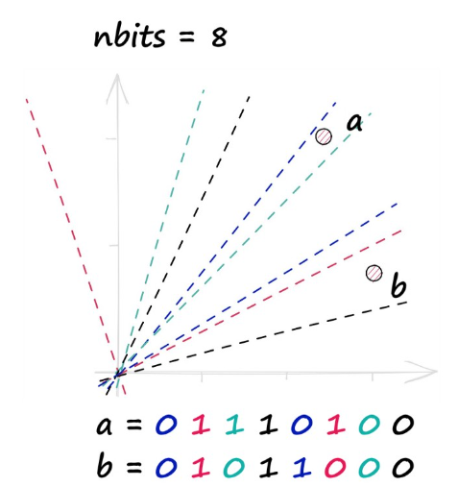
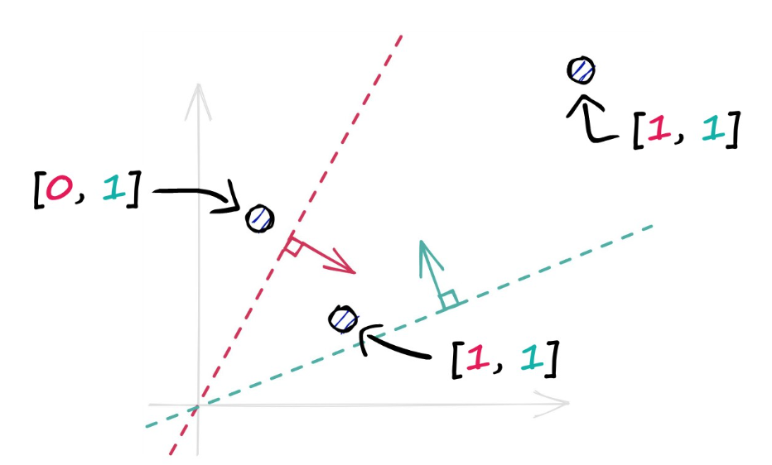
Locality-sensitive hashing: Random projection
Cool explanations: https://www.pinecone.io/learn/locality-sensitive-hashing-random-projection/
We randomly sample n hyperplanes
For each vector: bit=0 if on the left of the hyperplane, otherwise bit=1
We discretize the cosine similarity
More bits = more accurate

Slide 25
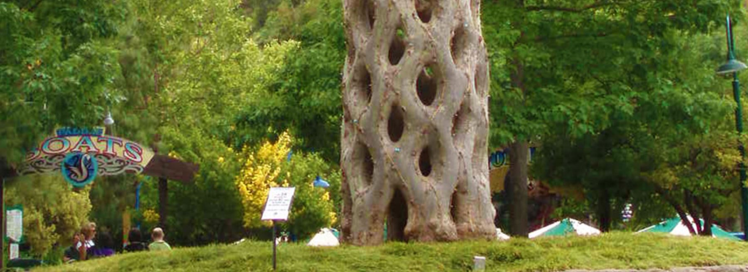
4- Graph

Slide 26
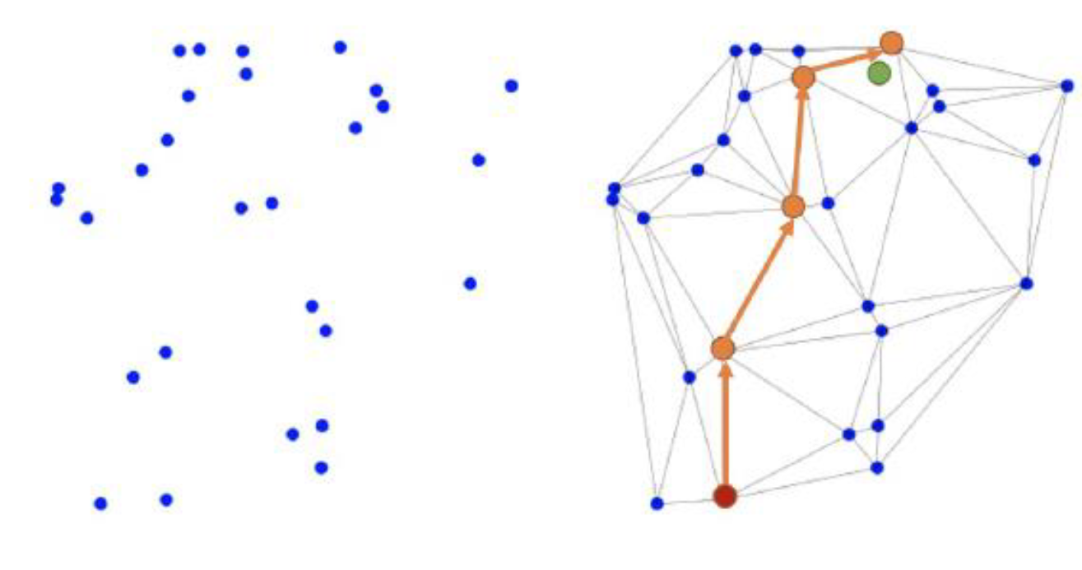
Graph-Based KNN
The idea is to connect the vectors together in order to form a graph
Then to search in the graph:
Initialize an empty list
Repeat n times:
Start from a random vector
Greedily navigate to reach the k closest vectors to the query vector in the graph
Update you list to keep the top k closest
But how to build such a graph???

Slide 27
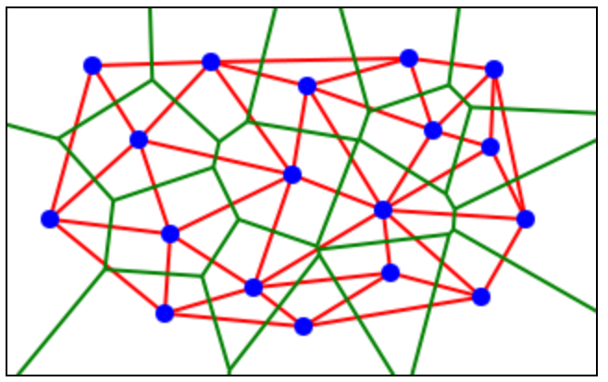
Delaunay Graph (<1975)
item
Voronoï diagram
Delaunay graph
All points within a Voronoï tile have contained blue point as their nearest neighbor.
Don’t expect to have Log(N) by navigating the graph naïvely ! Needs post processing
Does not wok in high dimension space ! (too many connections, too slow)
Notes:
(one can always try to compress the space before using this method : https://arxiv.org/pdf/1802.02422.pdf)

Slide 28
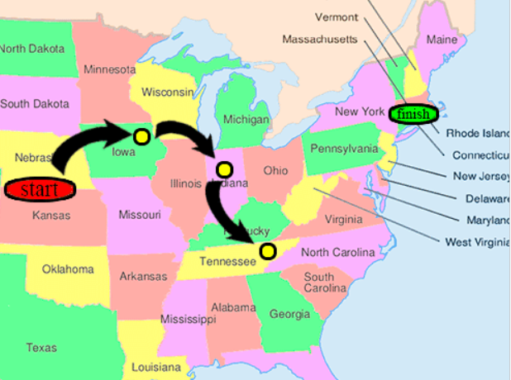
NSW (Navigable Small World)
« All people are six or fewer social connections from each other »
First manuscript written in ~1950 in Paris Sorbonne and circulated a lots. Milgram took up experiments 20 years later : take two random persons and see if/how the origin can manage to contact the destination.
Small world property exists in the nature !
Notes:
https://publications.hse.ru/mirror/pubs/share/folder/x5p6h7thif/direct/128296059

Slide 29
NSW (Navigable Small World)
How do we create small world network ?
In social networks : Dual Phase Evolution
Local phase : people spend most of their time with people they know
Global phase : party/event/hollidays, where people interact with people they don’t know
Links are created during global phases, refined/destroyed in local phase.
Notes:
https://publications.hse.ru/mirror/pubs/share/folder/x5p6h7thif/direct/128296059

Slide 30
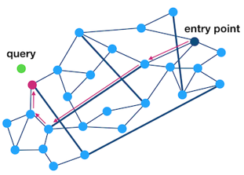
Small world network : is it enough ?
Notes:
https://publications.hse.ru/mirror/pubs/share/folder/x5p6h7thif/direct/128296059

Slide 31
NSW (Navigable Small World)
Navigable property guarantees that greedy algorithm is likely to stay on the sortest path.
Construction : try to enforce every node is connected to its M nearest neighbors.
Search : BFS (piorize neighbors nearest to the query), with stop condition : Worst neighbor found is better than best candidate to visit.
Works not too bad but performance degradations in low dimension / clustered graph.
Notes:
https://publications.hse.ru/mirror/pubs/share/folder/x5p6h7thif/direct/128296059

Slide 32
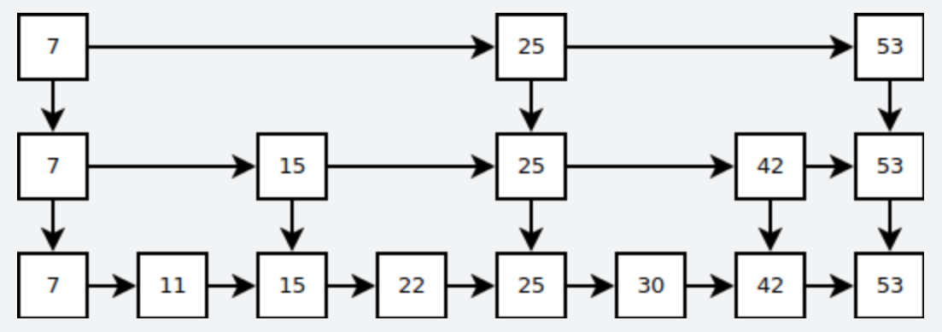
HNSW (Hierarchical NSW)
Idea
https://arxiv.org/ftp/arxiv/papers/1603/1603.09320.pdf
Add ‘highways’ to NSW
Same idea than skip-list and post-processing on Delaunay Graph !

Slide 33
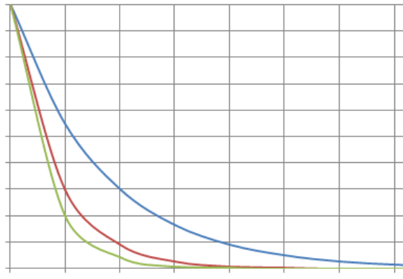
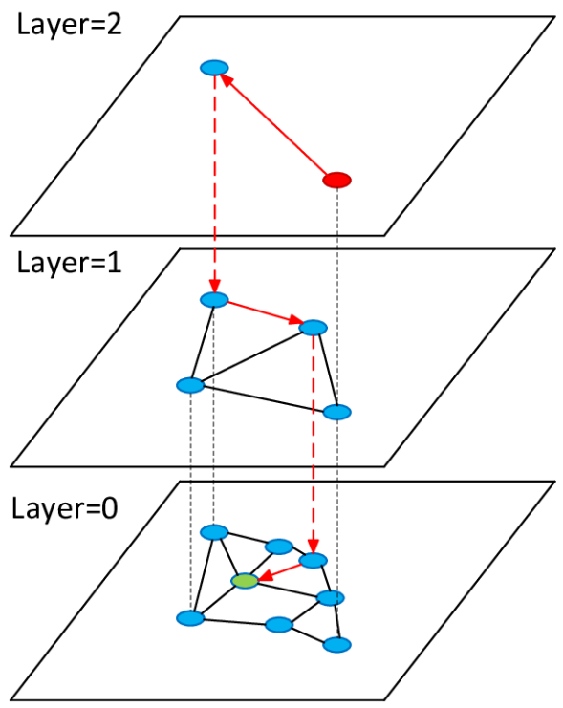
HNSW - Construction
probability
InsertNode(node, start)
Pick it’s level L randomly (exponential decay law)
current ⬅ start
# search in upper layers
for layer in MaxL..L+1:
current ⬅ KNNSearch(node, current, 1, layer)
# fill lower layers
for layer in L..0:
neighbors ⬅ KNNSearch(node, current, M2, layer)
toConnect ⬅ select(node, neighbors, M)
for n in toConnect:
connect node and n
shrink connections of n
current ⬅ neighbors
KNNSearch(query, start, k, layer)
//returns k closest neighbor to query
BFS from starting point, explore points nearest to query first.
Stop condition
Worst neighbor found is better than best candidate to visit.
layer
https://arxiv.org/ftp/arxiv/papers/1603/1603.09320.pdf
Notes:
https://arxiv.org/ftp/arxiv/papers/1603/1603.09320.pdf

Slide 34
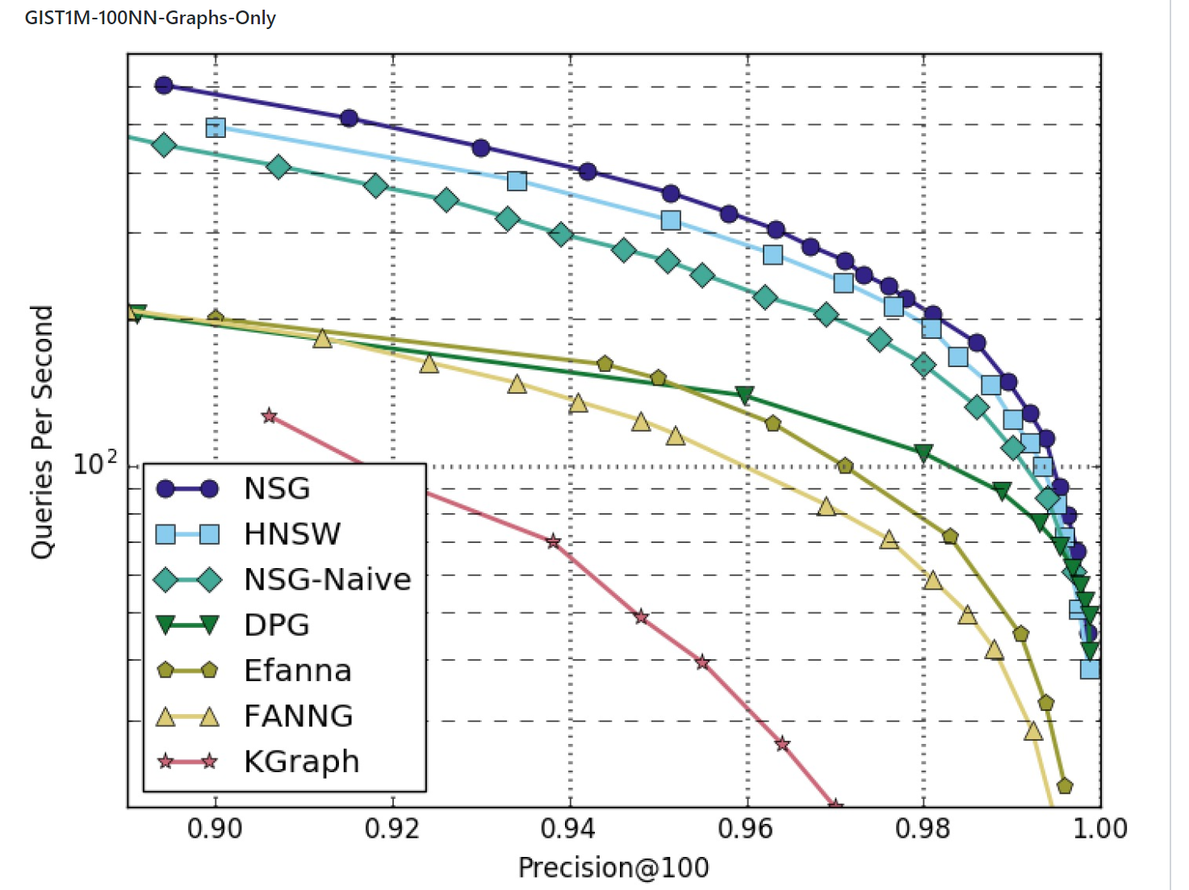
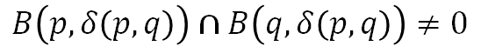
Still state of the art ?
EFANNA NSG (Alibaba)
http://www.vldb.org/pvldb/vol12/p461-fu.pdf
Connect p and q iif :
$$B\left(p, δ\left(p,q\right)\right)∩B\left(q,δ\left(p,q\right)\right)≠0$$
Notes:
Sift dataset (image descriptors)
100 nearest neighbor !

Slide 35
Still state of the art ?
NGT ONNG (yahoo Japan)
Same principle than hnsw with extra heuristics to decide which connections to cut when a node has too many connections.
https://arxiv.org/pdf/1810.07355.pdf
Notes:
https://arxiv.org/pdf/1802.02422.pdf : no comparison with other works

Slide 36
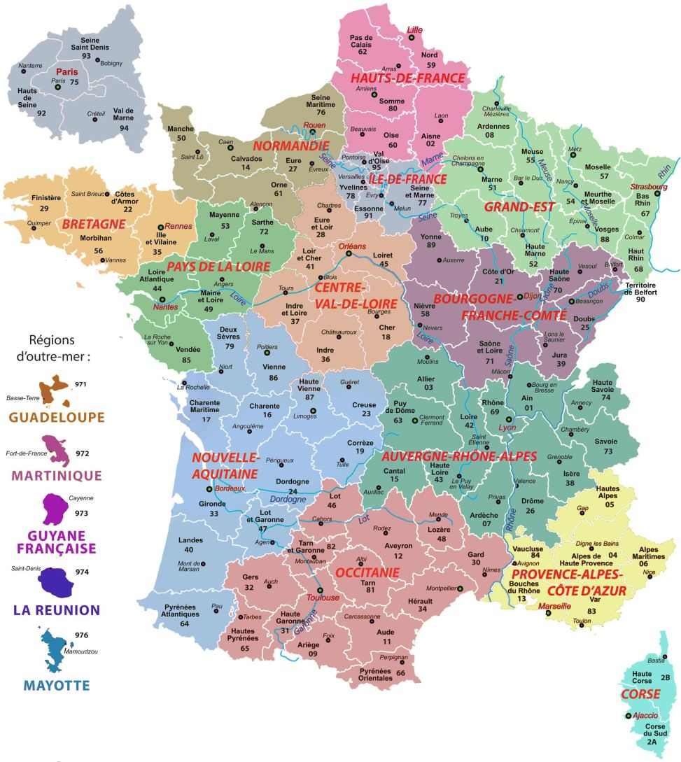
5 - IVF

Slide 37
IVF (Inverted Flat index)
Index construction
K-mean algorithm to find N clusters
Put each vector in the corresponding cluster
Search time
Find the closest cluster centers using an exhaustive index
Then, explore all the points in the previously selected clusters and select the k closest to the input query.

Slide 38
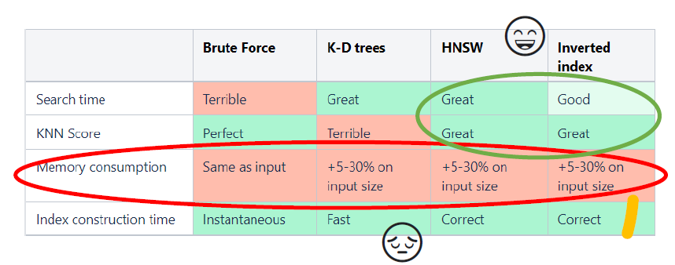
Congrats! You now know the main categories of KNN indices!
The bad news is that all these algorithms use too much RAM so scale to Billions of items!

Slide 39
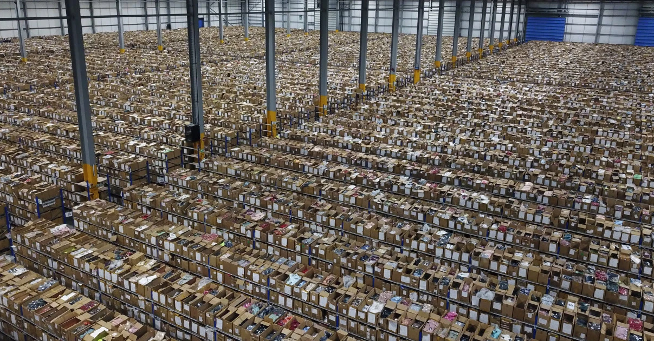
6 – Quantized Indices

Slide 40
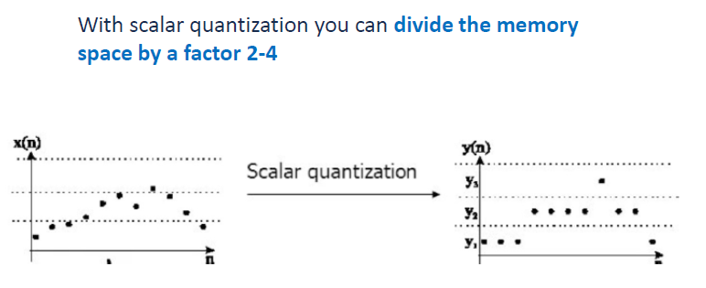
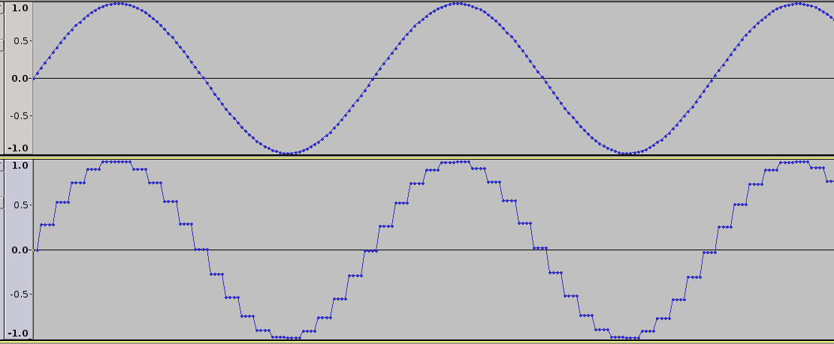
Scalar quantization

Slide 41
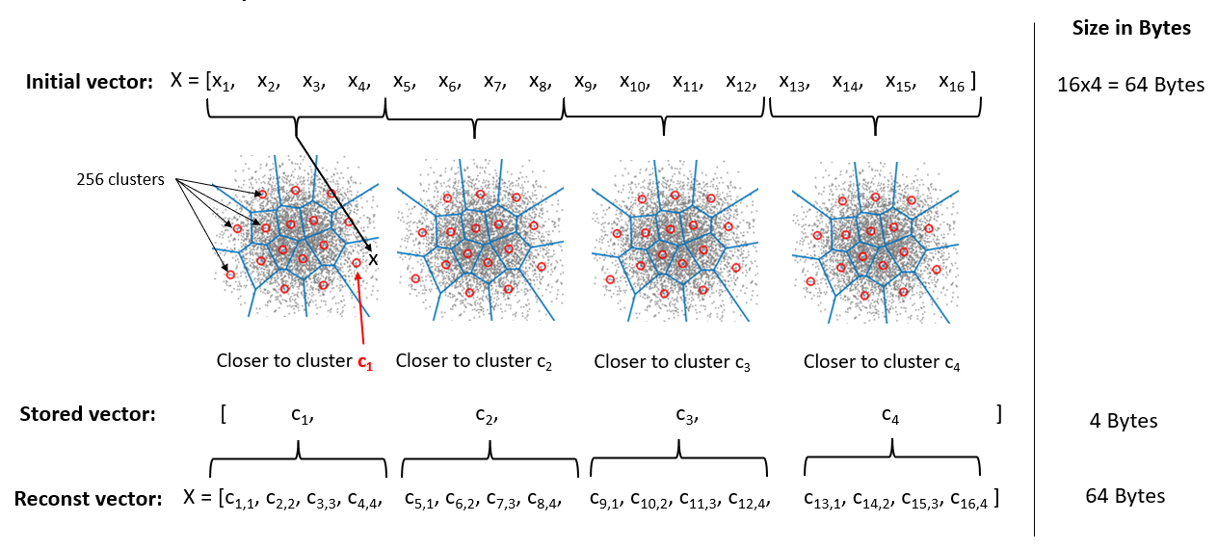
Product Quantization

Slide 42
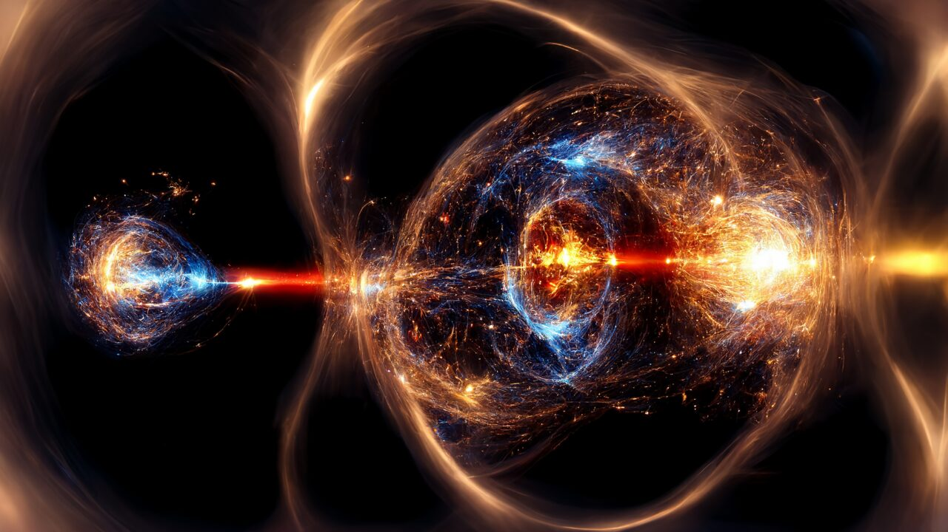
7 – KNN Fusion

Slide 43
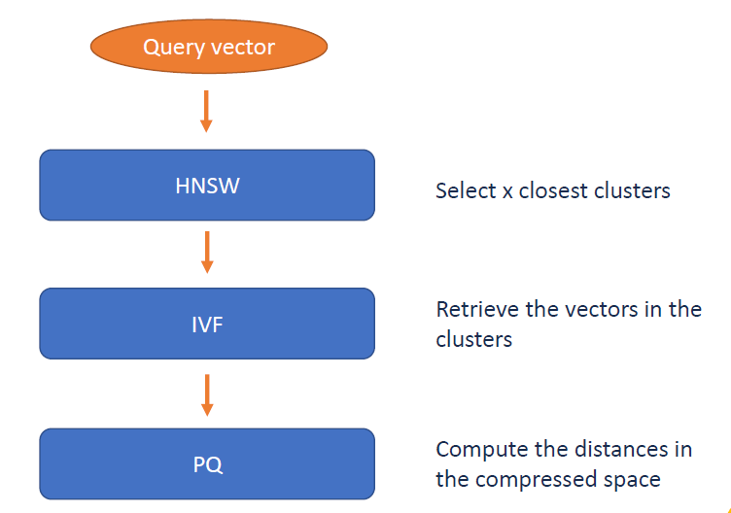
OPQ64_256,IVF131072_HNSW32,PQ64x8-nprobe=18,efSearch=36,ht=2048.index

Slide 44
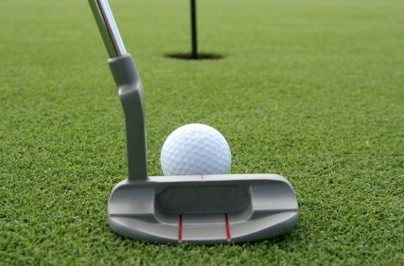
8- KNN in practice!

Slide 45
KNN in practice!
Faiss: a library implementing very efficiently the most common indexing algorithms
C++ lib with many bindings (ex: python)
Github: https://github.com/facebookresearch/faiss
Hnswlib: Opensource library for HNSW, Criteo contributed actively on it
C++ lib with python and Java bindings
Github: https://github.com/nmslib/hnswlib
Autofaiss: Opensource python library to automatically create KNN indices from your dataset (Can create in few hours)
Wrapper library on top of Faiss to simplify its usage
It is possible to build a large (400 million vectors, 2TB) KNN index in 3 hours -in a low amount of memory (16 GB) with latency in milliseconds (10ms)
Medium article: https://medium.com/criteo-engineering/introducing-autofaiss-an-automatic-k-nearest-neighbor-indexing-library-at-scale-c90842005a11
Github: https://github.com/criteo/autofaiss

Slide 46
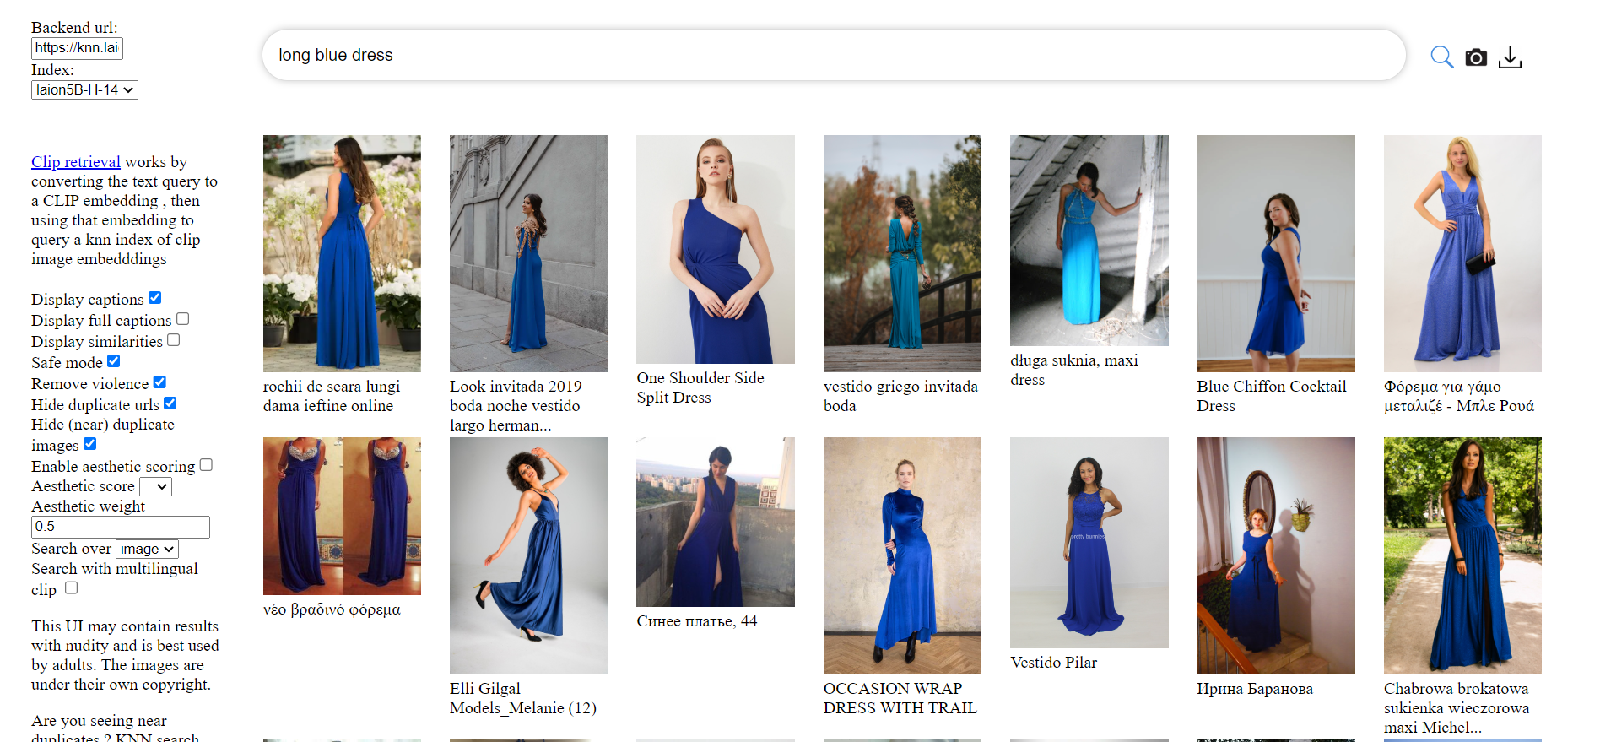
Real life example
https://rom1504.github.io/clip-retrieval/?back=https%3A%2F%2Fknn.laion.ai&index=laion5B-H-14&useMclip=false

Slide 47
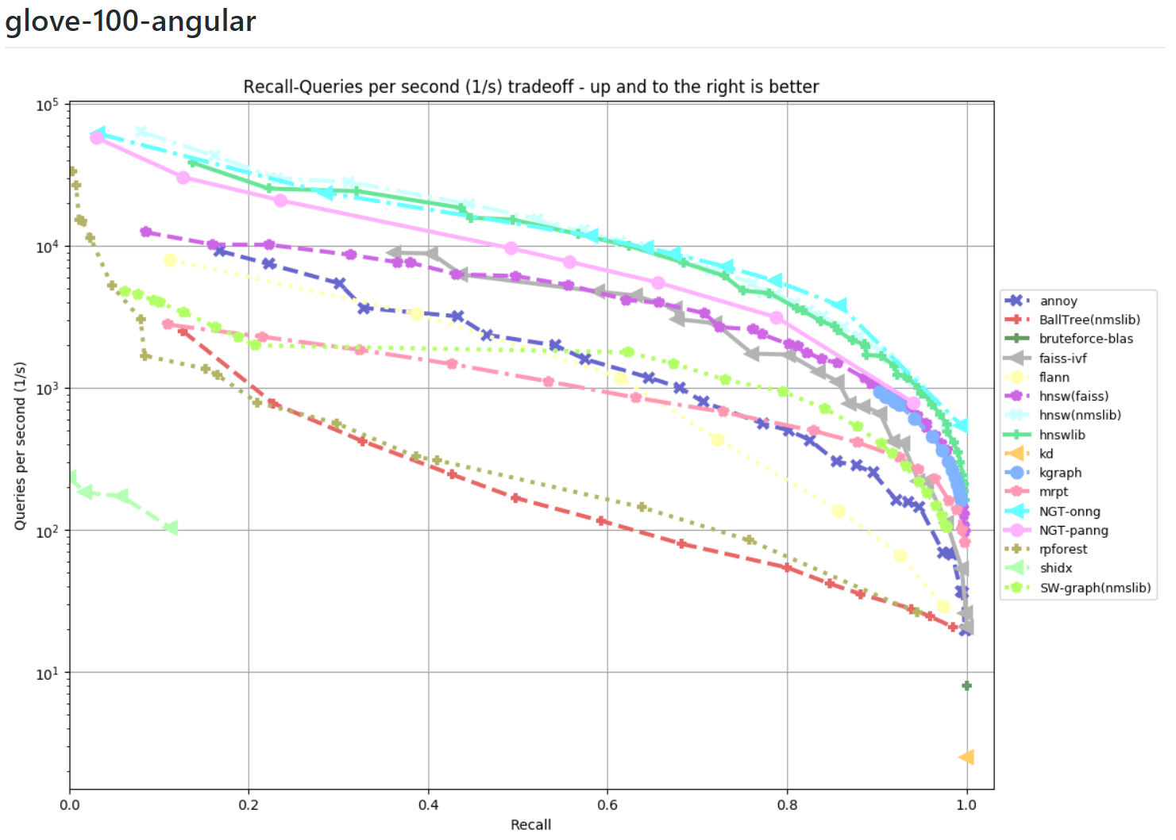
Benchmark Results
Notes:
Glove : word representations

Slide 48
Current research in the domain
Hybrid KNN (DiskANN, SPANN, …)
Optimization for inner product (QUIPS, SCANN, …)
Compressed embeddings at training time (ROBE-Z, SCMA, …)
NeurIPS’21: Billion-Scale Approximate Nearest Neighbor Search Challenge (http://big-ann-benchmarks.com)

Slide 49
Time to practice!

